Slide 1
Status Report #16
2020. Feb 27 (Thu)
B4 FUJIWARA Tomomasa
Prepare for B4 thesis presentation
New Board design
ToF cosmic: 5 mm thickness

Slide 2
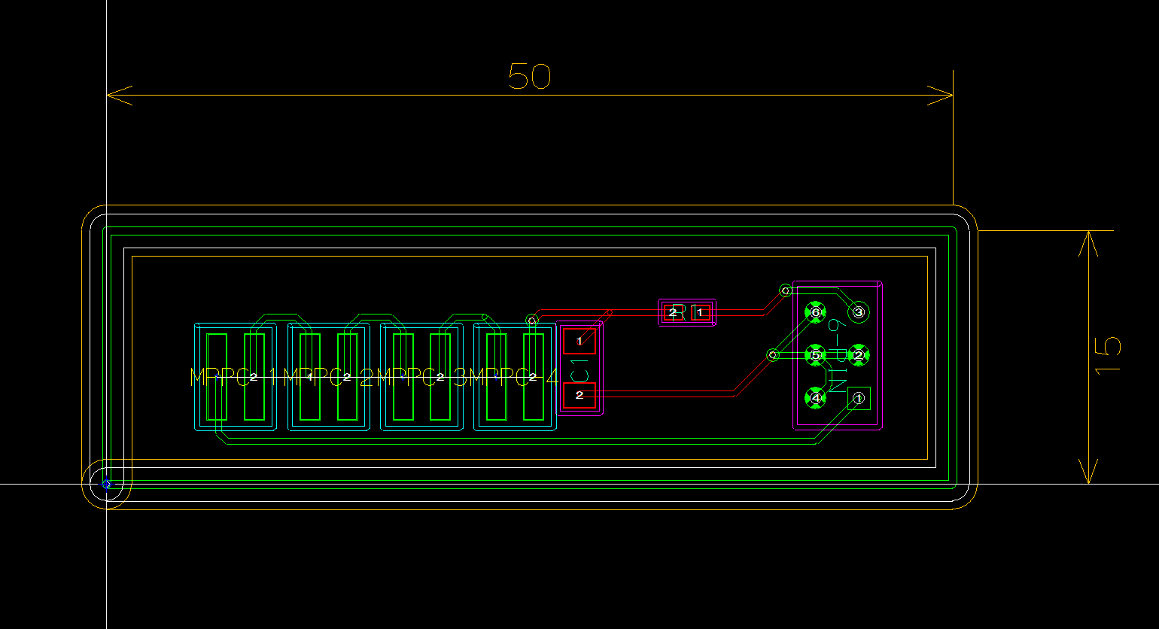
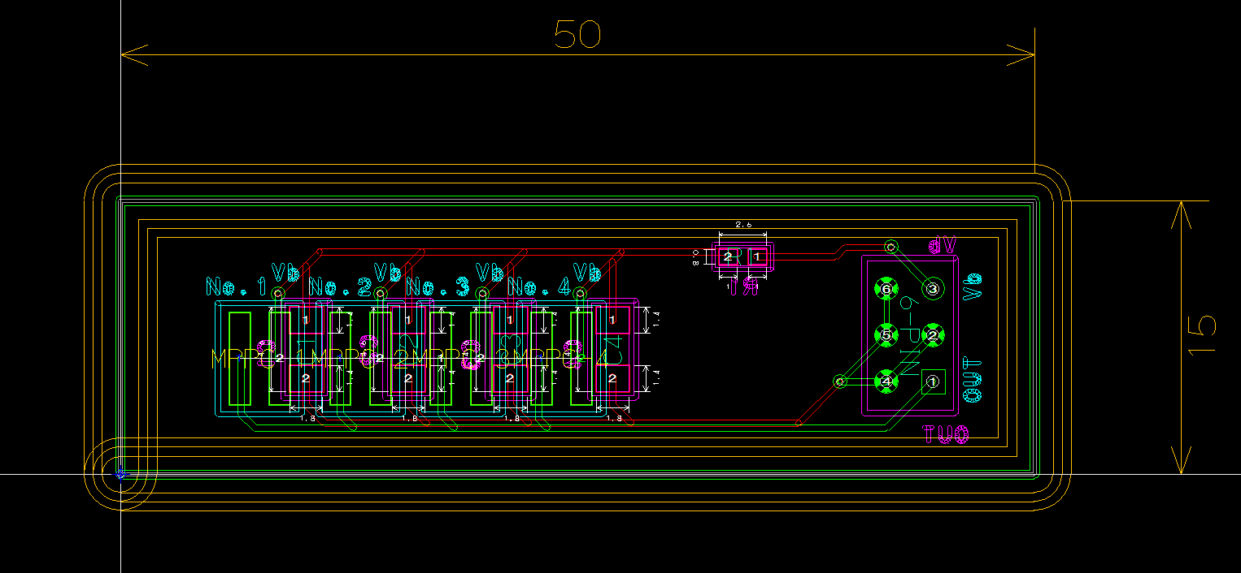
New circuit design
Series connection (直列)
Parallel connection (並列)

Slide 3
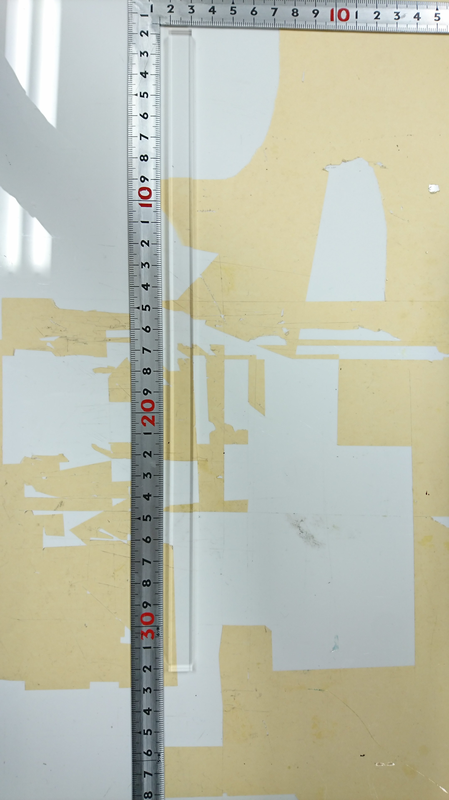
ToF cosmic: 5 mm thickness scintillator at V_{b} = 44.7 V
New scintillator
t = 5 mm
w = 11 mm

Slide 4
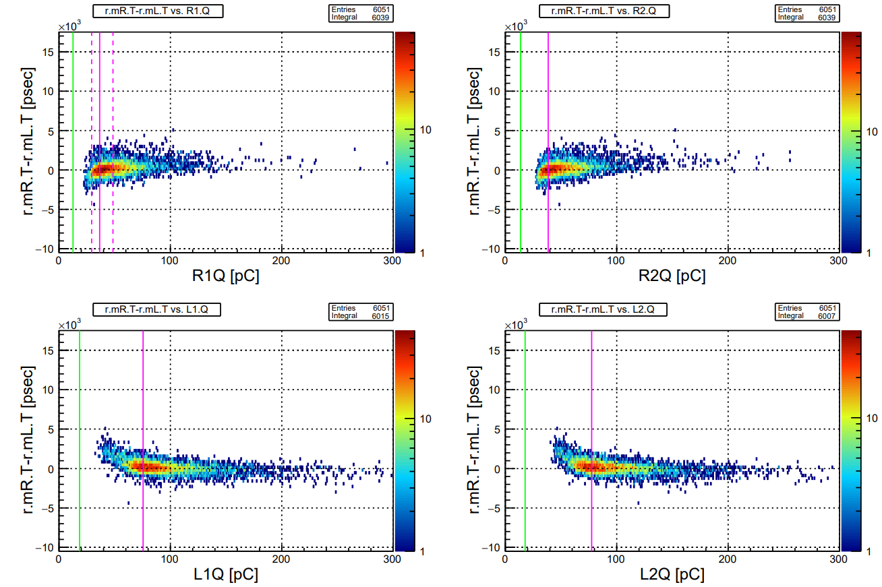
ToF cosmic: 5 mm thickness scintillator at V_{b} = 44.7 V
5 mm
Raw ToF vs. QDCs
10 mm

Slide 5
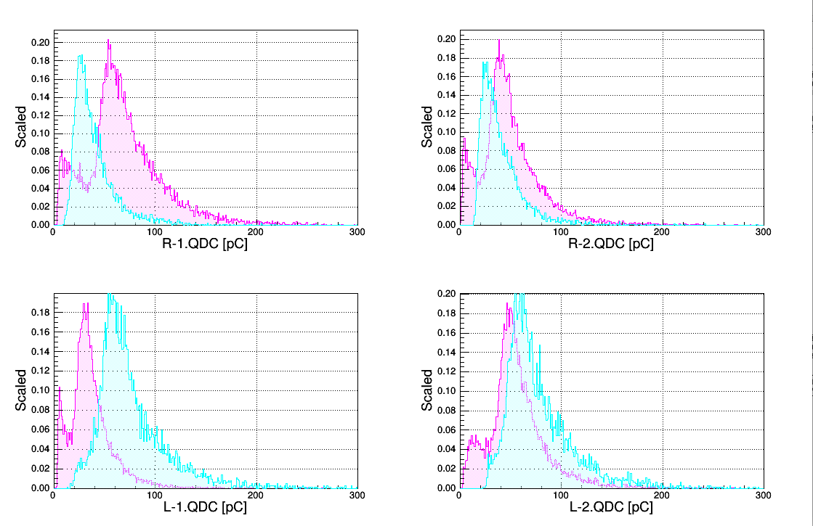
ToF cosmic: 5 mm thickness scintillator
Compare QDC dist. w/ 10 mm thickness
Cyan: 5 mm
Magenta: 10 mm
MPV: ~27 pC
MPV: ~27 pC
MPV: ~57 pC
MPV: ~39 pC

Slide 6
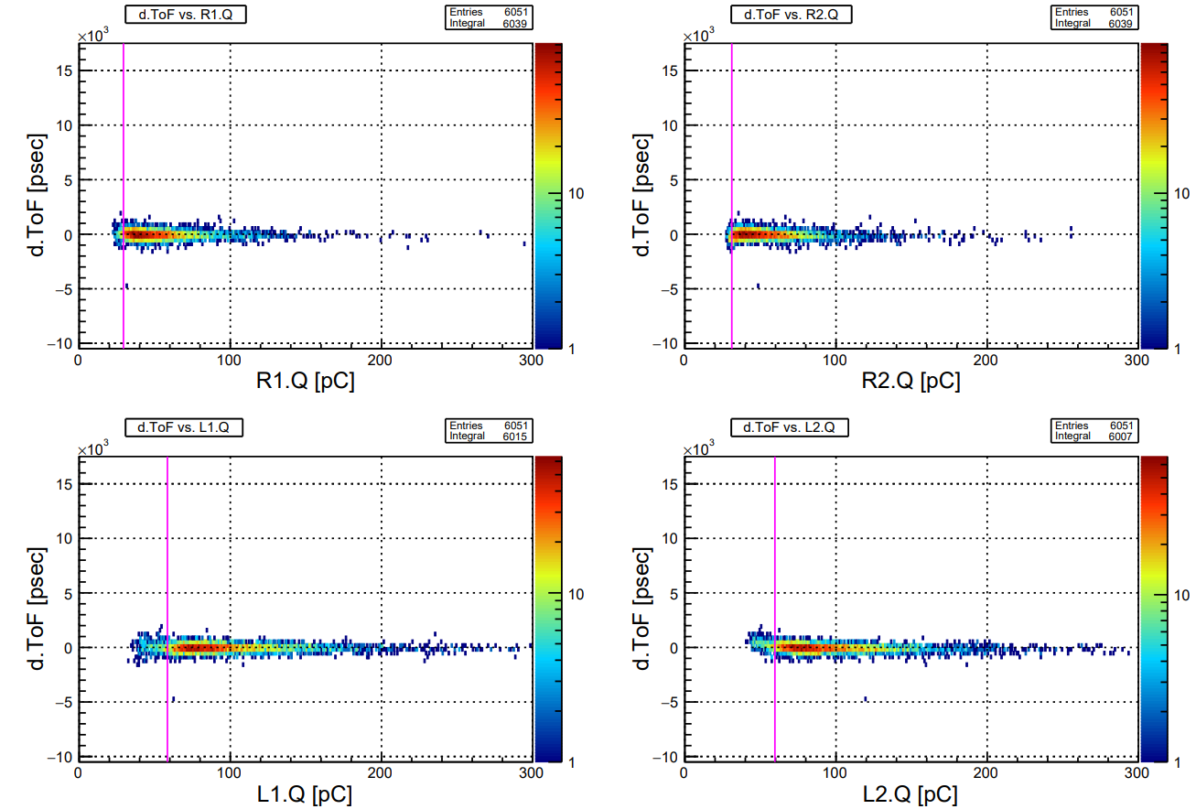
Time Walk Correction

Slide 7
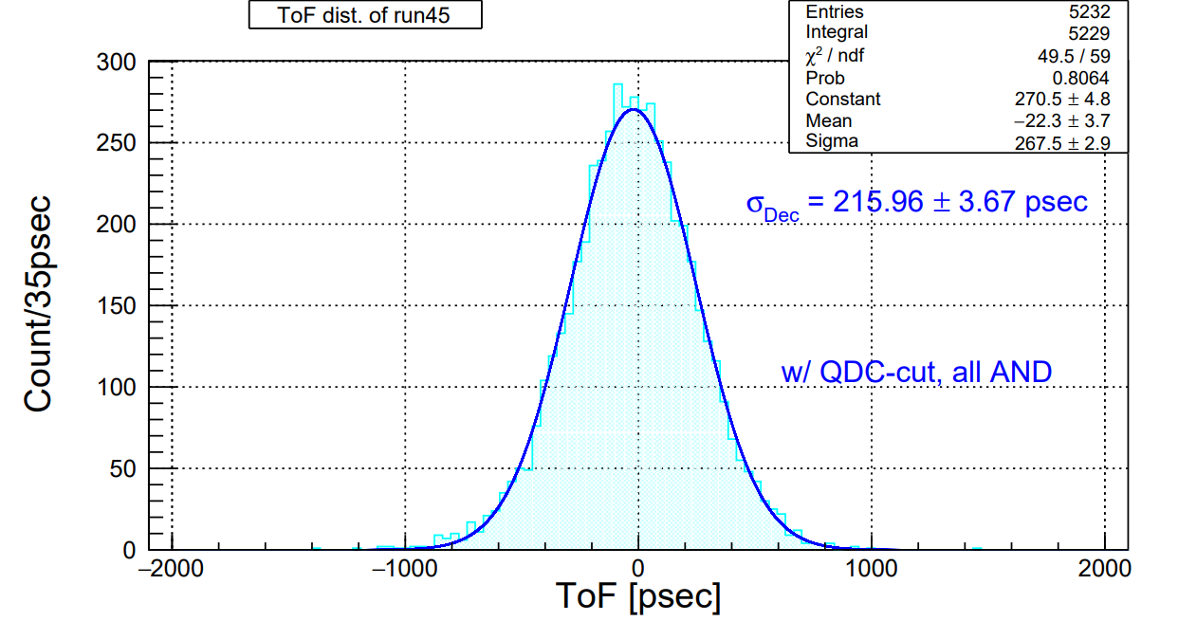
ToF dist. After time walk correction

Slide 8
Consideration
Threshold too high ?
R-1, 2: ~ -140 - 180 mV (MIP ~ -760 mV )
L-1, 2: ~ -280 mV (MIP ~ -570 mV)
High rate w/ β – ray : ~ 100k Hz
Light leakage ??

Slide 9
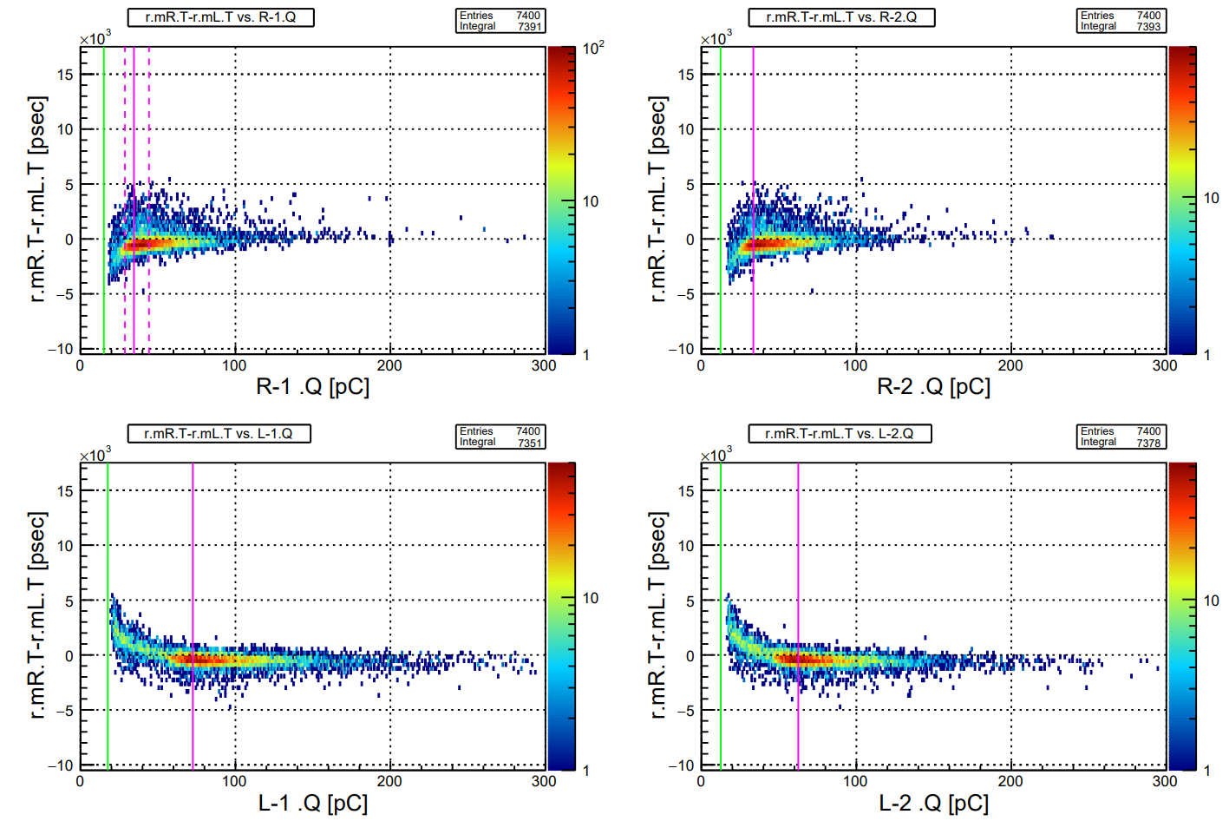
Retry after repair at V_{b} = 44.7 V
Raw ToF vs. QDCs

Slide 10
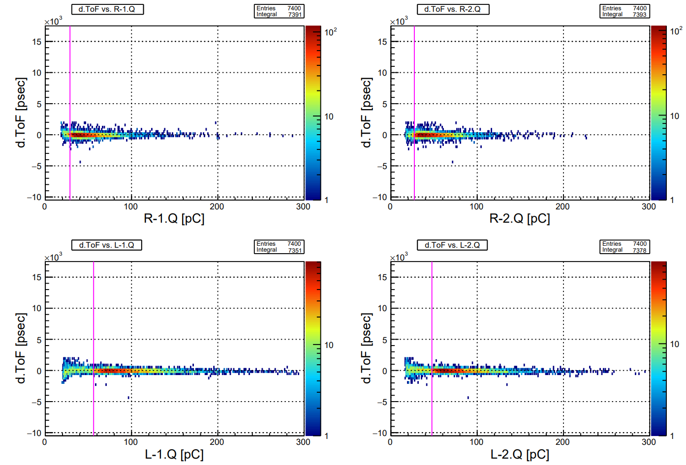
Retry after repair at V_{b} = 44.7 V

Slide 11
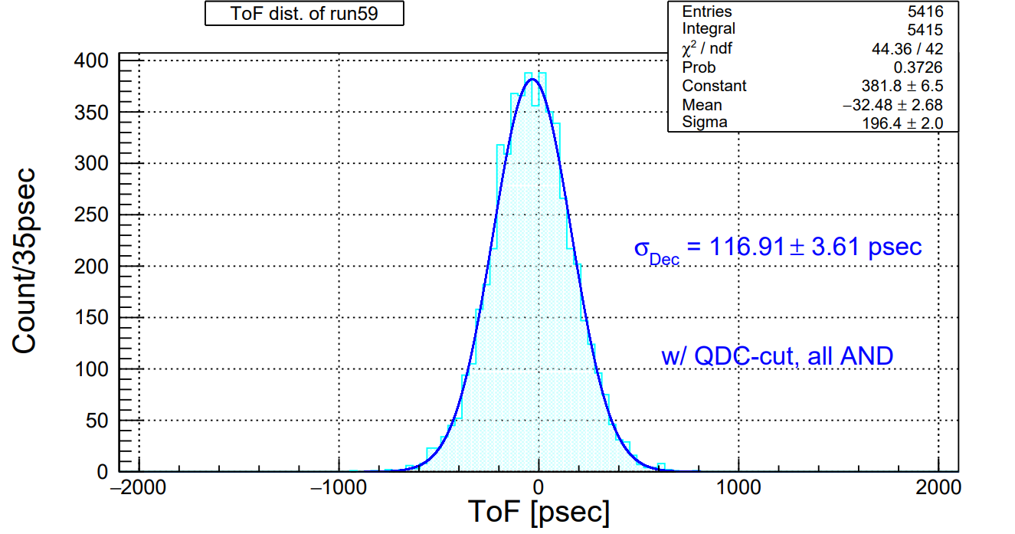
Retry after repair at V_{b} = 44.7 V

Slide 12
To do next
B4 thesis presentation (tomorrow)
Bias scan w/ 5 mm thickness scintillator: V_{b} – V_{op} = 0.0, +3.0, +6.0 V
Test w/ 22 & 44 mm width scintillator (Now: 11 mm )

Slide 13
New circuit design
Parallel connection (並列)

Slide 14
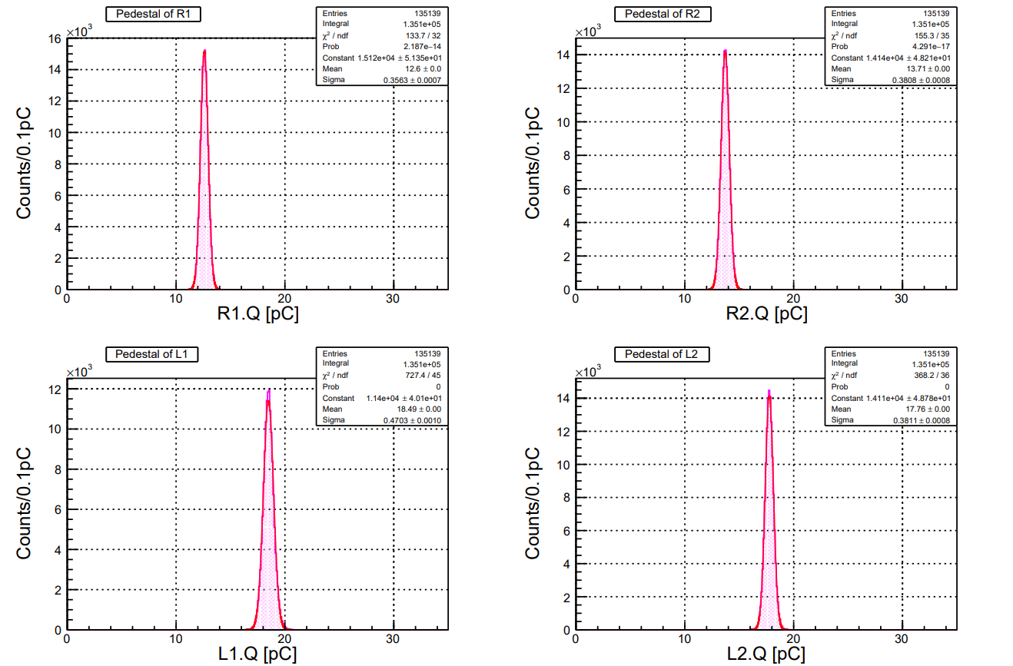

Slide 15
ToF: thickness & width study
Before Time walk correction

Slide 16
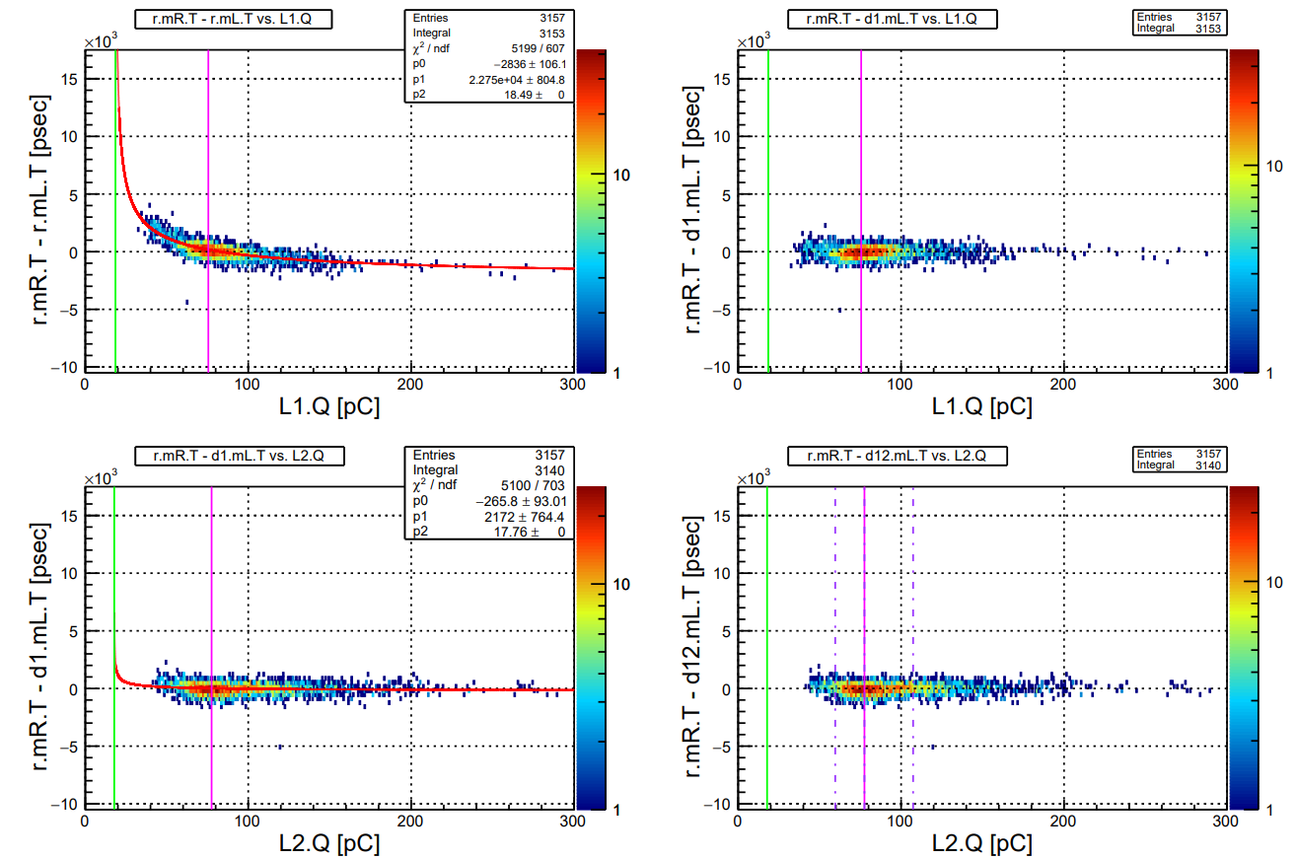
ToF: thickness & width study

Slide 17
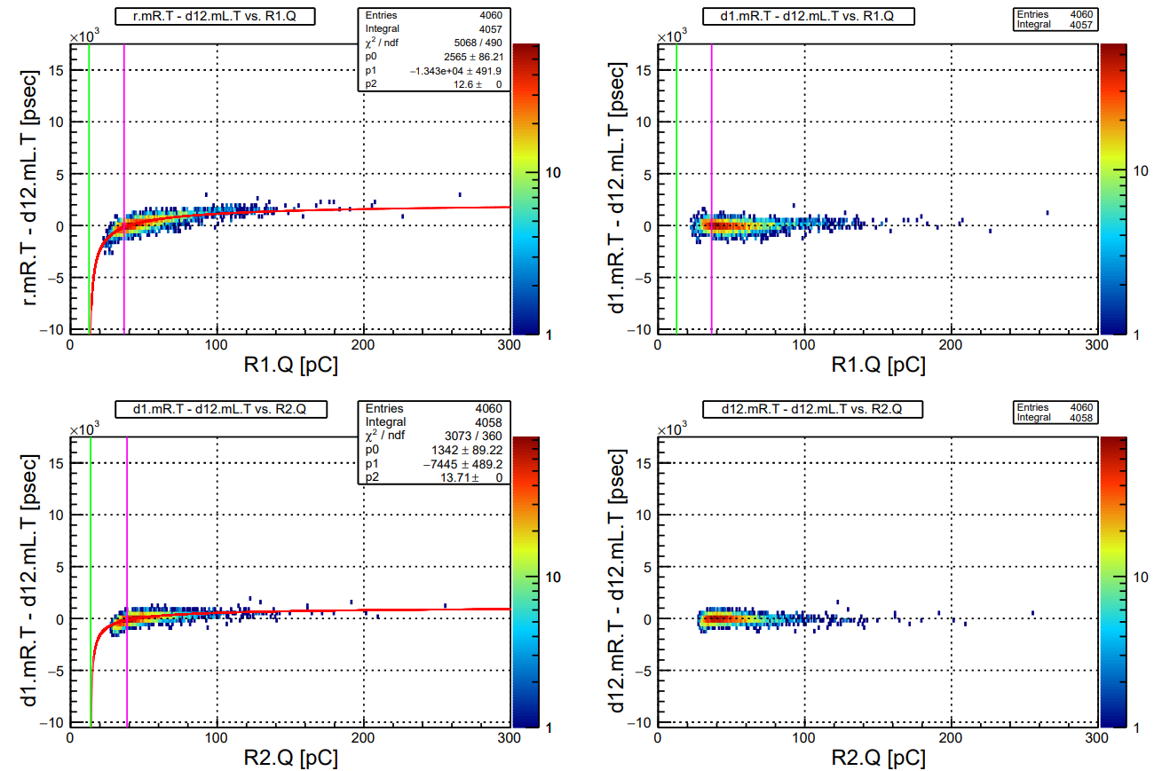

Slide 18
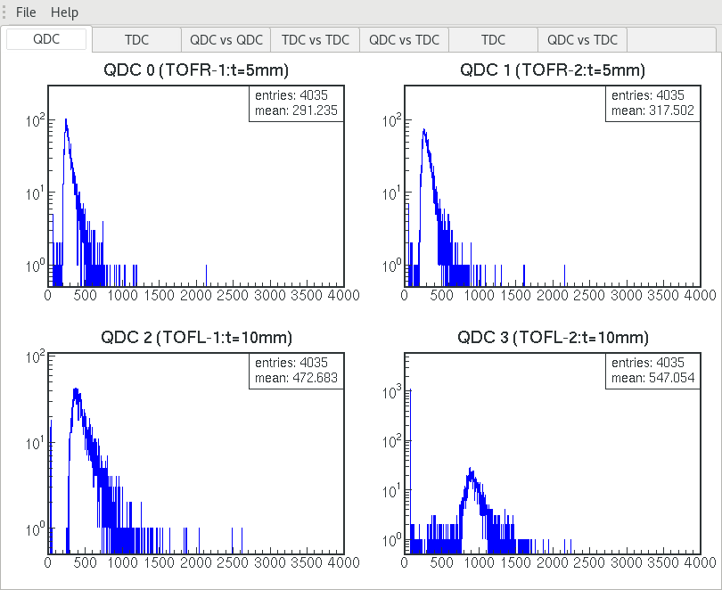

Slide 19
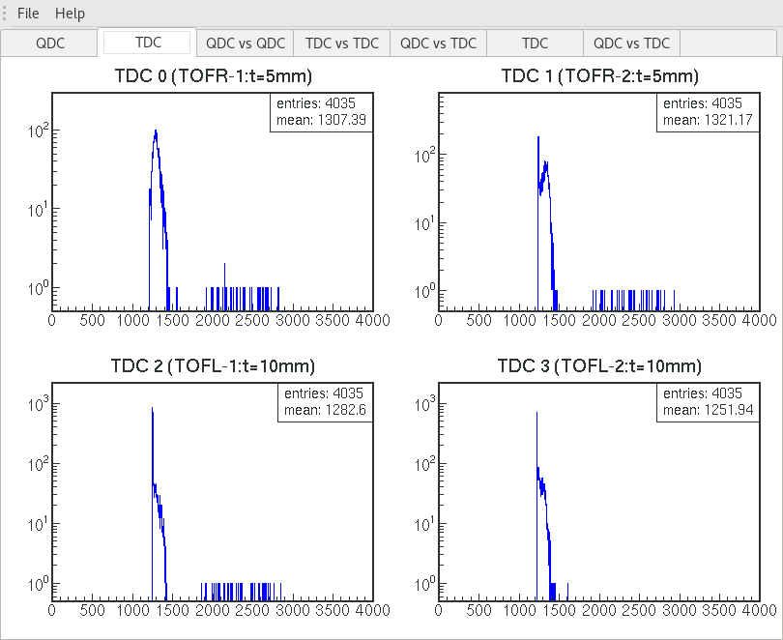

Slide 20
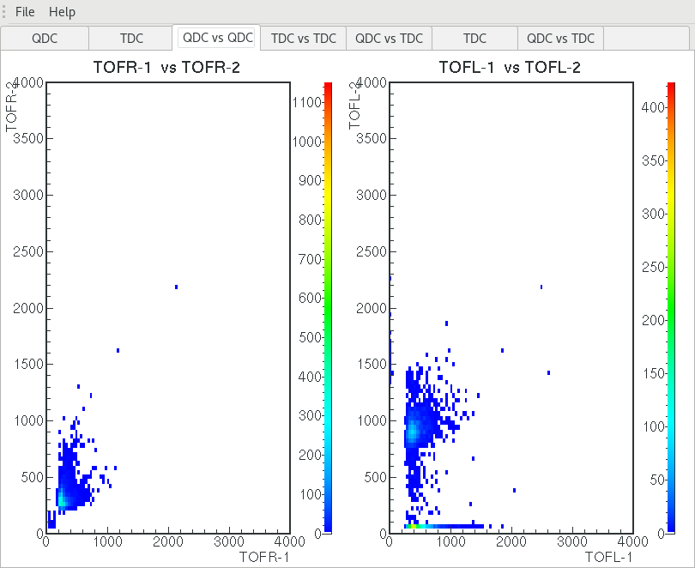

Slide 21
